Slide 1
UNCOVERing Deep Rooted Cultural Differences Aleksey Panasyuk Information Fusion Technology Branch Air Force Research Lab Rome, New York, USA aleksey.panasyuk@us.af.mil Bryan Li, Chris Callison-Burch University of Pennsylvania, Philadelphia PA 19104, USA bryanli@seas.upenn.edu; ccb@seas.upenn.edu
Approved for Public Release; Distribution Unlimited: PA CLEARANCE Case Number: 2024-0352

Slide 2
UNCOVER Initial Objective
Using English and Russian Wikipedia, can we:
identify propaganda
highlight areas of disagreement and agreement
Approved for Public Release; Distribution Unlimited: PA CLEARANCE Case Number: 2024-0352

Slide 3
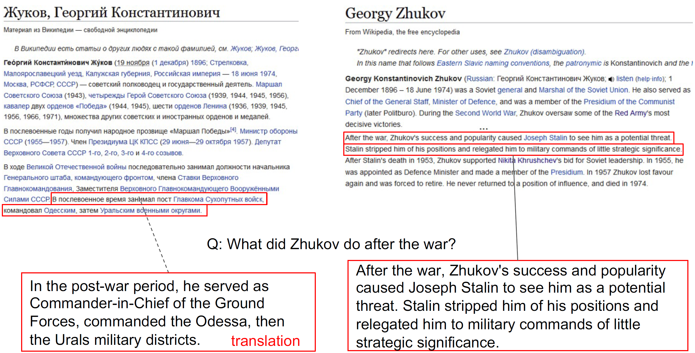
Initial Concept
Approved for Public Release; Distribution Unlimited: PA CLEARANCE Case Number: 2024-0352

Slide 4
Background
Combating influence campaigns necessitates a multi-faceted approach across the interconnected realms of Debates, Fake News, and Propaganda.
Fake news (facts): deliberate disinformation and unintentional misinformation, such as inaccurate captions or translations, and satire taken seriously. Check the reputation of the source, validate images and videos to identify manipulation, and employ fact-checking websites.
Debates (facts + technique): structured discussions or formal arguments on specific topics, where participants present opposing views. They rely on logical reasoning, factual evidence, and articulate expression to persuade.
Propaganda (selective facts + misleading techniques): Careful use of rhetoric and presentation skills can sway opinions, sometimes independent of the factual correctness of the arguments. Presenting information in a biased or misleading manner, using emotional appeal, selective truths, and sometimes outright falsehoods to achieve a specific agenda.
Approved for Public Release; Distribution Unlimited: PA CLEARANCE Case Number: 2024-0352
Notes:
Although these areas are closely related, each presents unique features and seemingly necessitates the development of specialized analytical models. However, LLMs hold the promise of a unified approach that could span these research fields.

Slide 5
Challenges and Approach
Challenge | Approach
Wikipedia is huge over 1.3 Million Article Pairs between RU and EN | Generate a targeted Wikipedia dataset that in Russian have references to known state sponsored news such as tass.ru
Need to focus on narrative sections | Remove bibliographic, discographic, or accolade sections. Remove tables, HTML, and excessive white space
Generate Questions that can be used to extract propaganda | Utilize an existing propaganda detection dataset for developing questions, performing statistical analysis, and using the top questions as features
Cross-lingual Question Answering | Apply translation to get 4 datasets: Russian (RU), English (EN), Russian to English (RU2EN) and English to Russian (EN2RU). Also translate questions into Russian.
Highlight areas of disagreement and agreement between RU and EN | Utilize Answers to Questions for comparing and ranking articles
Approved for Public Release; Distribution Unlimited: PA CLEARANCE Case Number: 2024-0352
Notes:
Russian and English (1m+ paired articles)

Slide 6
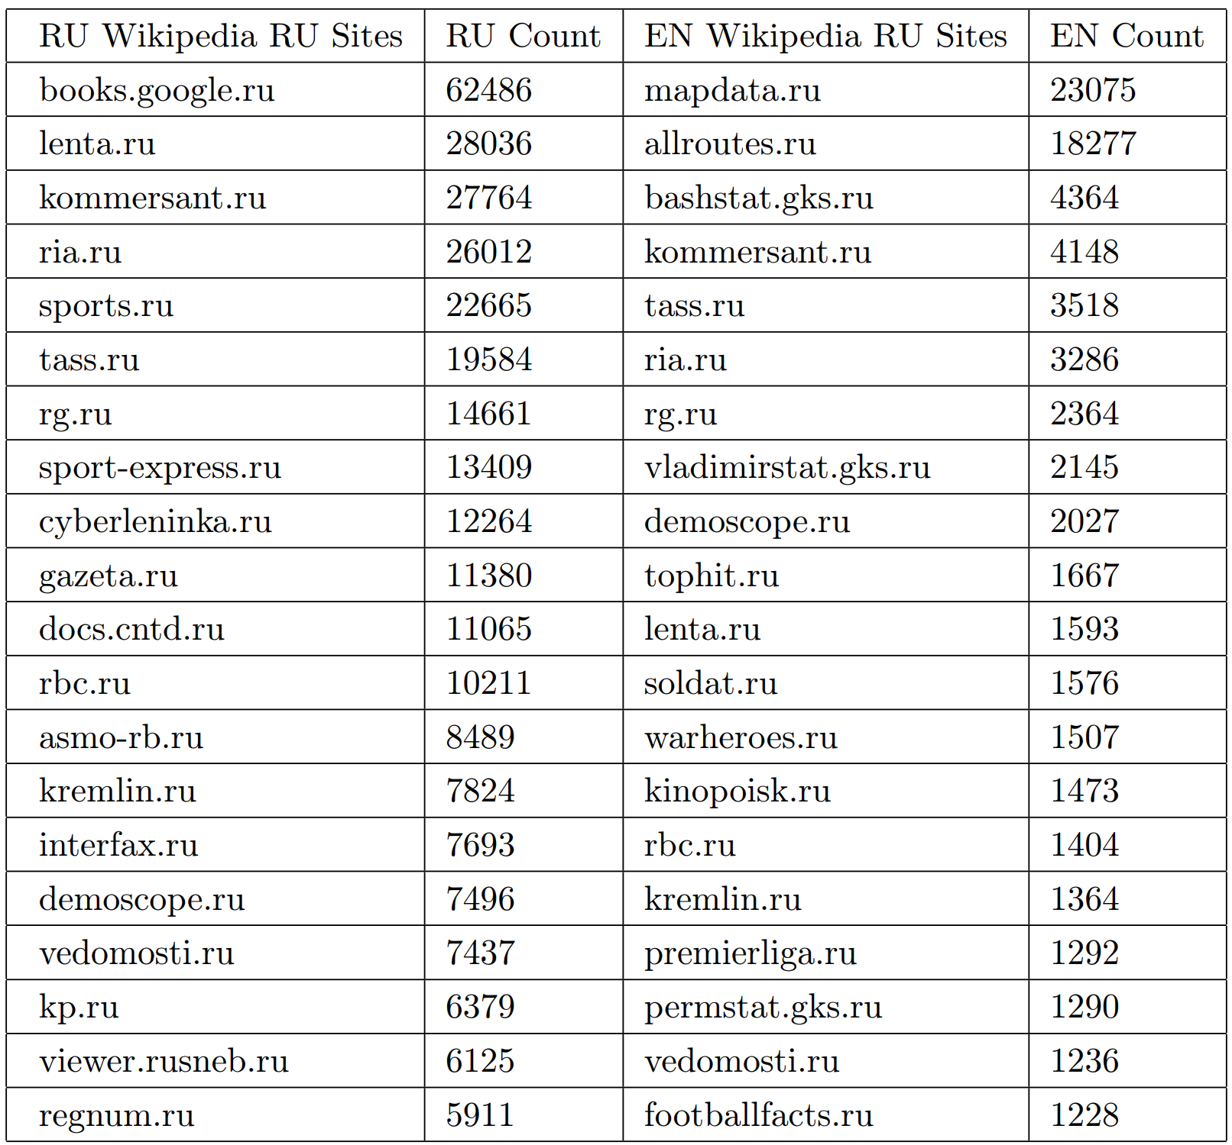
Challenge 1 Approach: Focus on .ru domain to generate a targeted dataset
We go from 1,308,962 to 22,046 article pairs.
30 Russian news sites that are likely to contain propaganda: ’lenta.ru’, ’kommersant.ru’, ’ria.ru’, ’tass.ru’, ’rg.ru’, ’gazeta.ru’, ’rbc.ru’, ’kremlin.ru’, ’interfax.ru’, ’demoscope.ru’, ’vedomosti.ru’, ’kp.ru’, ’regnum.ru’, ’vesti.ru’, ’echo.msk.ru’, ’novayagazeta.ru’, ’ng.ru’, ’rian.ru’, ’publication.pravo.gov.ru’, ’1tv.ru’, ’vz.ru’, ’iz.ru’, ’aif.ru’, ’rosbalt.ru’, ’izvestia.ru’, ’intermedia.ru’, ’top.rbc.ru’, ’polit.ru’, ’fontanka.ru’, ’ntv.ru’.
Focus on articles that have at least 2 narrative sections and a total article char of at least 2000.
Approved for Public Release; Distribution Unlimited: PA CLEARANCE Case Number: 2024-0352

Slide 7
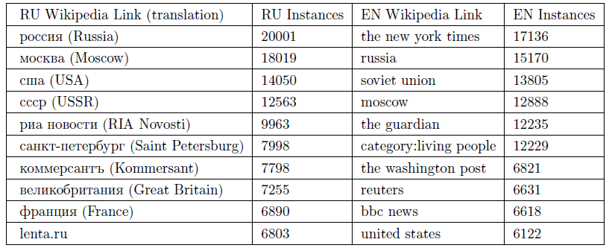
Top Links to other Wikipedia pages
After Filter 2, the pages related to the USA, France, Russia, Germany, and the UK were the most linked in Russian Wikipedia and Living People category, The New York Times, Russia, France, and the Association Football in English Wikipedia.
After Filter 3:
Approved for Public Release; Distribution Unlimited: PA CLEARANCE Case Number: 2024-0352

Slide 8
Challenge 2 Approach: focus on narrative sections
Remove tables, HTML, and excessive white space.
Remove sections that start with:
For English: [references, links, see, notes, further, sources, awards, club, results, honours, statistics, charts, works, cast, gallery, filmography, music, media, film, events, singles, discography, citations, league, team, games, video, record, albums, series, teams, nominations, literature, books, footnotes, certifications, honors, publications, records, appearances]
For Russian: [примечания, ссылки, литература, также, см, награды, достижения, источники, результаты, ролях, фильмография, галерея, достопримечательности, демография, композиций, участники, дискография, чарты, творчество, работы, номинации, альбомы, публикации, синглы, сочинения, фотогалерея, труды, финала, книги, кино, матч, финалы, команды, музыка, выступления, медалисты, матчи, премии, фильмы]
Approved for Public Release; Distribution Unlimited: PA CLEARANCE Case Number: 2024-0352

Slide 9
Challenge 3 Approach: Generate Questions that can be used to extract propaganda
Propaganda is a form of disinformation and a subset of fake news. Propaganda can be very subtle, with most of the article authentic, but a few tweaked elements. Example techniques:
Loaded Language: words/phrases with strong emotional implications (can be positive or negative)
Name calling or Labeling: the object of the propaganda is associated with something the audience loves, fears, respects (Putin associating Ukraine’s government with Nazis)
Repetition: Repeating the same message over and over again
Exaggeration or Minimization: making something seem more or less important (Putin calling war a special military operation)
Doubt: questioning the credibility of source or facts.
Sem-Eval 2023 Task 3 contains 11,780 labeled newswire examples for 23 persuasion techniques.
Approved for Public Release; Distribution Unlimited: PA CLEARANCE Case Number: 2024-0352

Slide 10
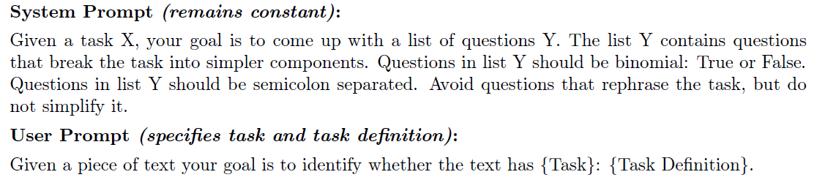
Chal 3 Step 0: GPT-4 prompt structure for generating questions related to propaganda
Approved for Public Release; Distribution Unlimited: PA CLEARANCE Case Number: 2024-0352

Slide 11
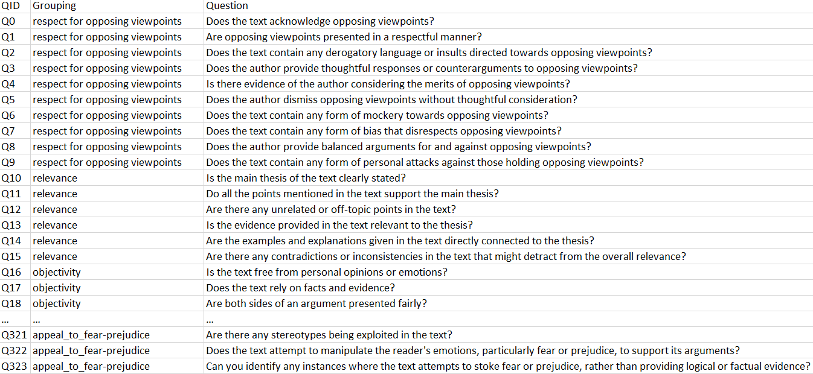
Chal 3 Step 1: prompt from previous slide used to generate a repository of questions (23 techniques + 22 communication and argumentation techniques + None => 324 questions):
Approved for Public Release; Distribution Unlimited: PA CLEARANCE Case Number: 2024-0352
Notes:
Communication practices: (1) Respectful Language, avoiding hate speech and derogatory terms; (2) Constructive Dialogue, focusing on ideas rather than personal attacks; (3) Empathetic Tone, appreciating others' feelings; (4) Open-mindedness, considering differing viewpoints; (5) Objectivity, maintaining factual accuracy without bias; (6) Active Listening, giving full attention to the speaker; (7) Nonviolent Communication, avoiding harmful speech; (8) Clear and Concise dialogue, minimizing misunderstandings; (9) Solution-Oriented discussions, seeking constructive resolution; and (10) Honesty, being straightforward yet respectful. The effective presentation of arguments: (1) a well-defined Thesis, (2) robust Evidence such as statistics and expert opinions, (3) Logical Reasoning with coherent thought progression, (4) Relevance of all points to the overarching thesis, and (5) addressing Counterarguments. The use of (6) Persuasive Language to evoke emotional responses, (7) Rhetorical Devices like metaphors, (8) Clarity in grammar and expression, (9) Factual Accuracy, and (10) Source Credibility is also crucial. Lastly, (11) Respect for Opposing Viewpoints and (12) Context awareness, which incorporates understanding of broader societal, cultural, historical, or political factors.
We negated the question if necessary such that the True answer implies that text has propaganda.

Slide 12
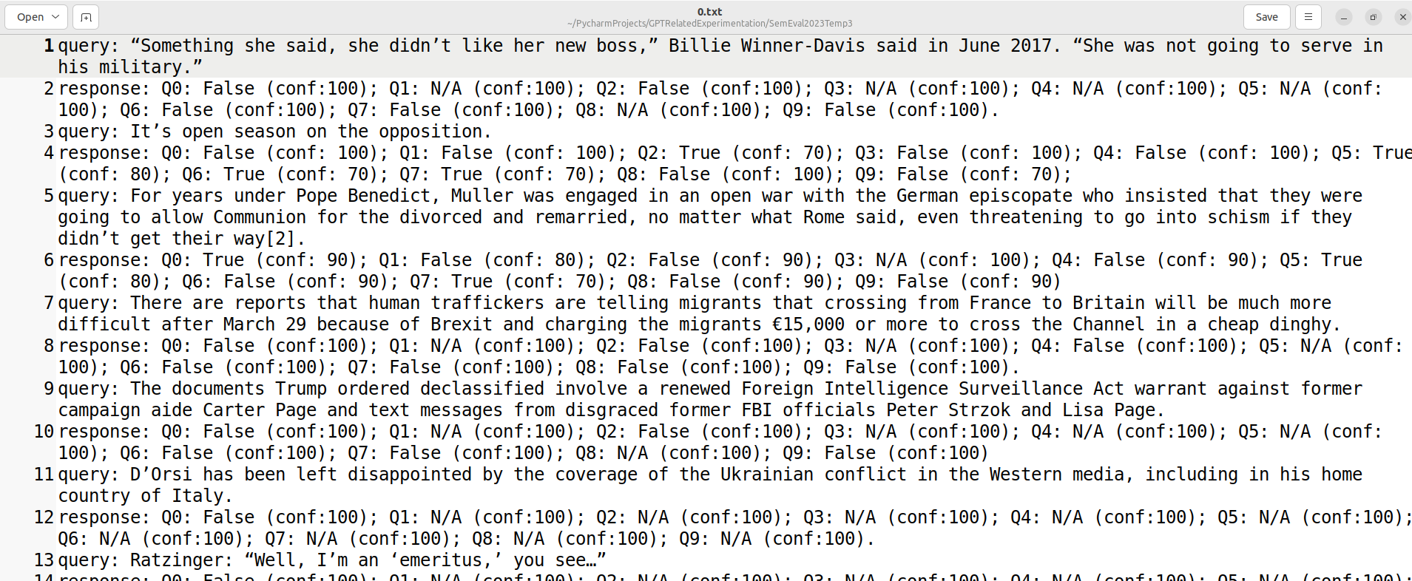
Chal 3 Step 2: The SemEval data processed (11,780 queries), GPT-4 task: Given a piece of text your goal is to answer each of the following questions as ‘True’, ‘False’, or ‘N/A’ (if question is not applicable) plus a confidence measure from 0-100. Questions: {list of questions}. Example output: Q1: True (conf:70); Q2: False (conf:30); Q3: N/A; ...
Approved for Public Release; Distribution Unlimited: PA CLEARANCE Case Number: 2024-0352
Notes:
Given a piece of text your goal is to answer each of the following questions as ‘True’, ‘False’, or ‘N/A’ (if question is not applicable) plus a confidence measure from 0-100. Questions: {list of questions}. Example output: Q1: True (conf:70); Q2: False (conf:30); Q3: N/A; ...

Slide 13
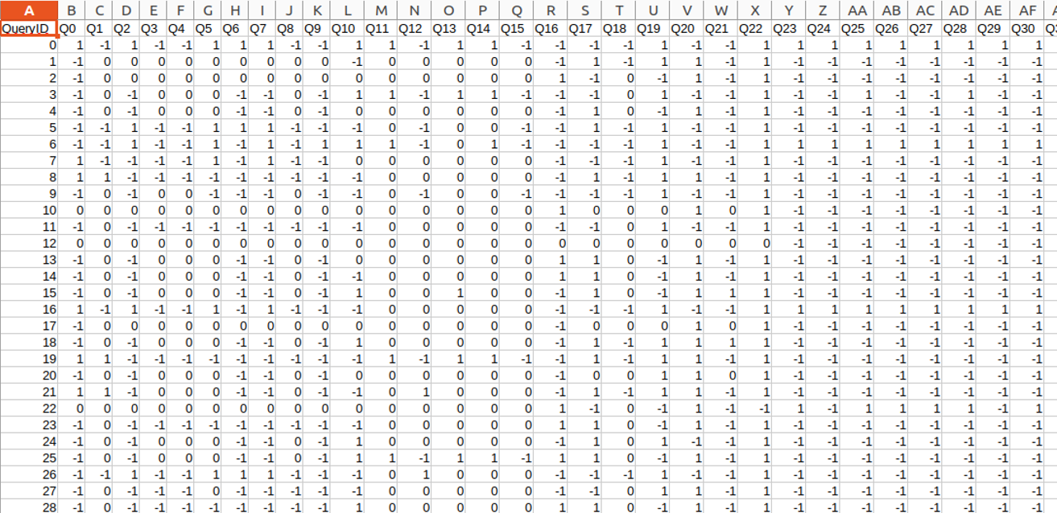
Chal 3 Step 3: Each question Q0-Q323 treated as a feature. True, N/A, False map to 1, 0, -1 creating a FeatureMatrix. For gold labels: 23 techniques + None if label is on 1 else 0. Confidence captured in separate matrix to be used later on.
Approved for Public Release; Distribution Unlimited: PA CLEARANCE Case Number: 2024-0352

Slide 14
Chal 3 Step 4: perform feature selection
1. ANOVA F-test: For numerical input and categorical output, the ANOVA F-test can be applied, and it is provided in scikit-learn via the `f_classif` function.
2. Feature Importance from Tree-based models: Decision Trees and ensemble algorithms such as Random Forest or Gradient Boosting can provide feature importances based on how helpful each feature is at reducing uncertainty (entropy or Gini impurity).
Approved for Public Release; Distribution Unlimited: PA CLEARANCE Case Number: 2024-0352

Slide 15
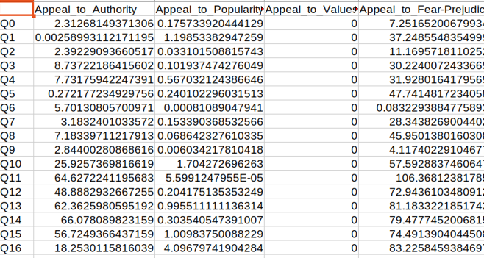
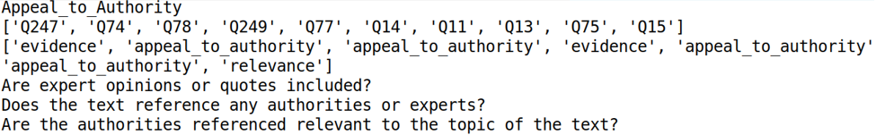
Snapshot of ANOVA Ranking
Example top Questions related to Appeal to Authority
Approved for Public Release; Distribution Unlimited: PA CLEARANCE Case Number: 2024-0352

Slide 16
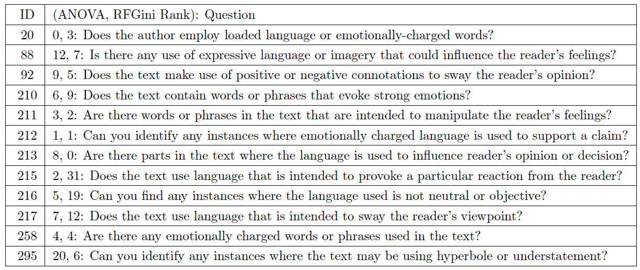
Top 12 High-Level Questions (HLQs) related to None
9 out of the 12 questions are related to loaded or emotional language.
This was expected given that ‘loaded language’ is by far the most frequent category in SemEval.
Approved for Public Release; Distribution Unlimited: PA CLEARANCE Case Number: 2024-0352
Notes:
Each question is related to task X as follows: Q20 pertains to objectivity, Q88 and Q92 address persuasive language to evoke emotional responses, Q210 through Q217 explore aspects of loaded language, Q258 associated with none, and Q295 examines the use of exaggeration or minimization.

Slide 17
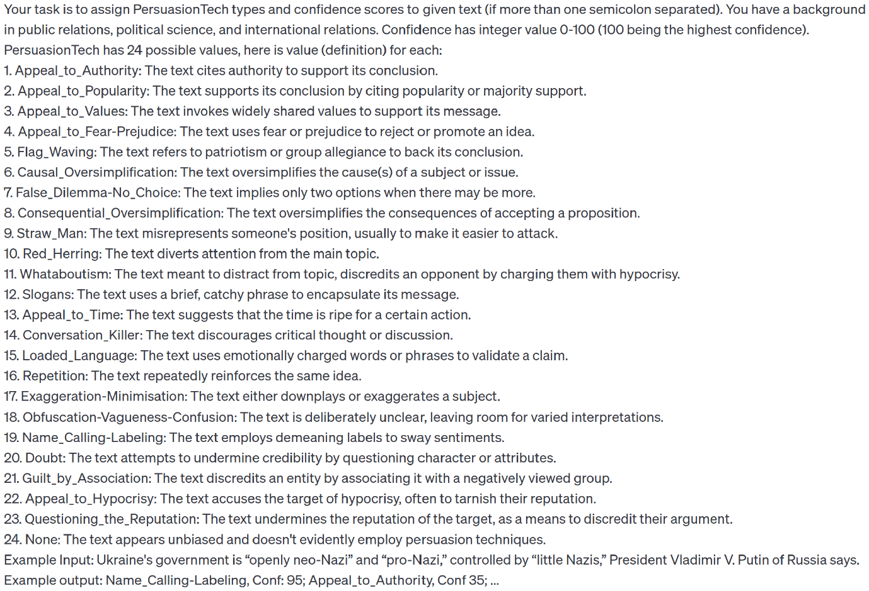
24 Technique Baseline
Approved for Public Release; Distribution Unlimited: PA CLEARANCE Case Number: 2024-0352

Slide 18
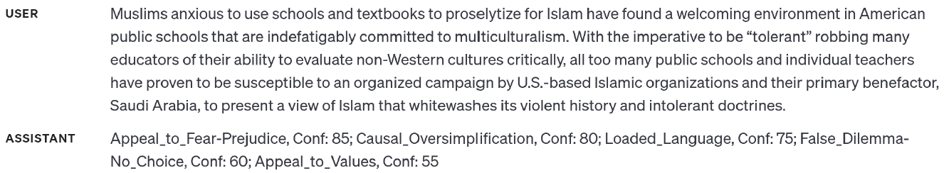
24 Technique Baseline Example
Approved for Public Release; Distribution Unlimited: PA CLEARANCE Case Number: 2024-0352
Notes:
Despite the zero-shot nature, we find the model nearly always adheres to the expected output format (< 1% error)

Slide 19
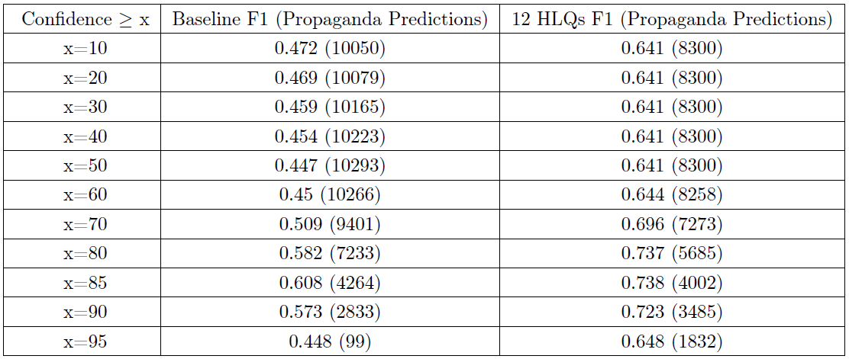
GPT-4 Zero-Shot 24 Definition Baseline vs. 12 HLQs
12 HLQs: class propaganda (if one or more HLQs answer affirmatively), else class None.
24 Definition Baseline: class propaganda if GPT-4 did not give None label and one or more persuasion techniques else class None.
Feature (persuasion technique or question) taken into account if its confidence surpasses a distinct threshold, denoted as x.
Approved for Public Release; Distribution Unlimited: PA CLEARANCE Case Number: 2024-0352
Notes:
Each question is related to task X as follows: Q20 pertains to objectivity, Q88 and Q92 address persuasive language to evoke emotional responses, Q210 through Q217 explore aspects of loaded language, Q258 associated with none, and Q295 examines the use of exaggeration or minimization.

Slide 20
Llama 2 (13B) Experimentation
While the one-shot identification prompt worked for GPT-4, Llama had many errors in instruction-following. Instead of “Q1: True (conf:70); Q2: False; ...” Llama will give short answer responses, with the model explaining each decision, and giving substantiating evidence.
0-shot prompts nearly never (<5%) output parsable responses, 1-shot prompts improve to ≈25%, and 2-shot and 3-shot prompts achieve to 45-50%.
We found that with pre-generation (and few-shot), instruction-following can improve to >90%.
Despite the correct output format, as for the actual task, Llama output has several issues compared to GPT-4: nearly always answers True for every question, has much higher confidence scores (most are 90-100), and gives answers out of order (e.g. Q0...Q1...Q9...Q4...).
Approved for Public Release; Distribution Unlimited: PA CLEARANCE Case Number: 2024-0352
Notes:
Considering the 50% of properly formatted responses, we observe that they are always prefixed with Q1:; in contrast, unparsable responses nearly always have different prefixes. This leads to the intuition that we can pre-generate the proper prefix by concatenating it to the input sequence. Afterwards, the model will continue generations in this modified distribution space;

Slide 21
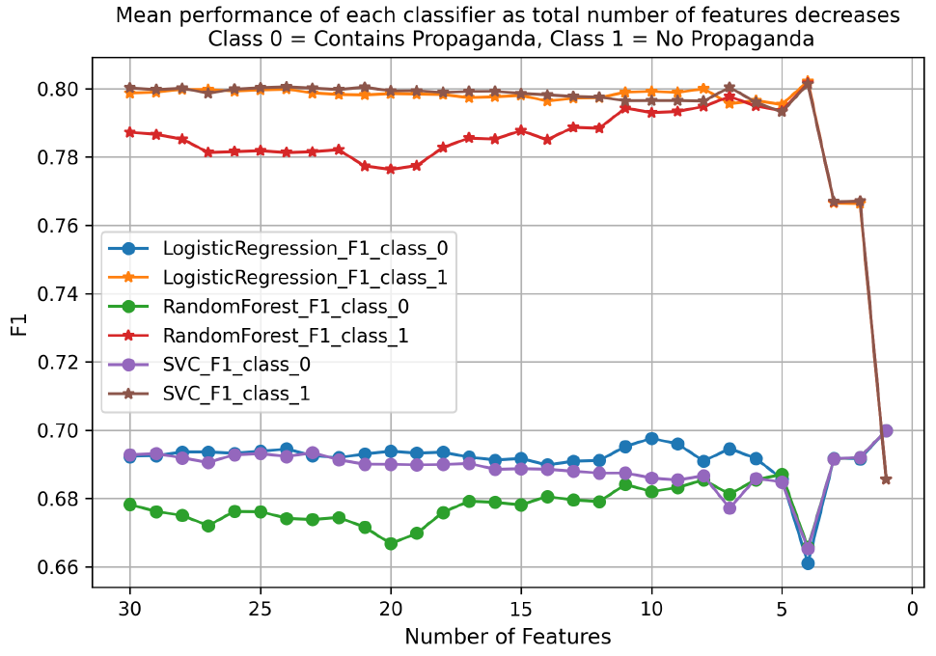
Approved for Public Release; Distribution Unlimited: PA CLEARANCE Case Number: 2024-0352
Notes:
the SemEval data was employed in a 5 fold cross-validation across a suite of classifiers, which included Logistic Regression, Random Forest, and Support Vector Classifier (SVC) (across classifiers kept seed parameter constant). The mean F1 across the 5 folds was recorded. Following the reduction of each feature set, we applied 5 fold cross-validation using the suite of classifiers again. For each iteration, we computed the mean precision, recall, and F1-score to quantitatively assess the classifiers' performance on the reduced feature set. Elimination of features for both ANOVA and RFGini reveals a stable performance across classifiers that starts to deteriorate after less than 10 features remain. There is a sharp drop in performance after top 8 features remain. We therefore take the top 8 selected features from feature reduction using ANOVA, and also the top 8 features from feature reduction using RFGini. As 4 questions overlap, this results in 12 features.

Slide 22
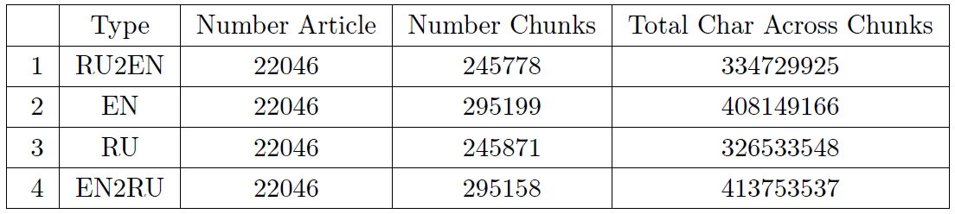
Each Wikipedia article by default contains sections. Within each section, the content is divided into chunks; where each chunk is not to exceed 3000 characters.
Challenge 4: Cross-lingual Question Answering
We also translate the 12 HLQs into Russian.
Approved for Public Release; Distribution Unlimited: PA CLEARANCE Case Number: 2024-0352
Notes:
found that for Russian-English translation, human translators preferred GPT-3.5’s translations at paragraph-level vs. sentence-level 100% of the time [1]
Translating by paragraphs provides a larger context size that allows for a more accurate translation [1]. By switching to chunk-level translations, we not only increase this context size, but also reduce the number of inference calls and facilitate a more efficient segmentation process.
[1] Karpinska, M. and Iyyer, M., “Large language models effectively leverage document-level context for literary translation, but critical errors persist,” arXiv preprint arXiv:2304.03245 (2023).

Slide 23
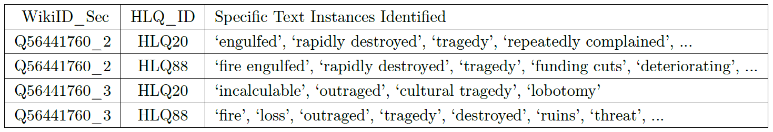
Challenge 5: Highlight areas of disagreement and agreement between RU and EN
Step 1: Apply 12 HLQs to the input text yielding True, False, N/A
HLQ295 (presence as hyperbole or understatement) has ~5.1% affirmative responses
Broader HLQ216 that scrutinize lack of neutrality or objectivity has ~16.8% affirmative responses
Step 2: Identify the exact part of the text that backs up the True answer
Step 3: Aggregate question responses across 12 HLQs, removing duplicate text:
Q56441760_2 for HLQ20 and HLQ88 should be reduced to [‘fire engulfed’, ‘rapidly destroyed’, ‘tragedy’, ‘repeatedly complained’, ‘funding cuts’, ‘deteriorating’]
with duplicates [‘engulfed’, ‘rapidly destroyed’, ‘tragedy’] removed.
Example Article ‘Fire at the National Museum of Brazil’:
Approved for Public Release; Distribution Unlimited: PA CLEARANCE Case Number: 2024-0352
Notes:
on average, there’s an 85.21% reduction in the number of chunks that need further processing in the subsequent step. This average is calculated across all HLQs over four data types.
Step 1 System prompt (apply 12 HLQs to the input text): Given a piece of text your goal is to answer each of the following questions as ‘True’, ‘False’, or ‘N/A’ (if question is not applicable) plus a confidence measure from 0-100. Questions: {list of 12 questions}. Example output: Q1: True (conf:70); Q2: False (conf:30); Q3: N/A; ...

Slide 24
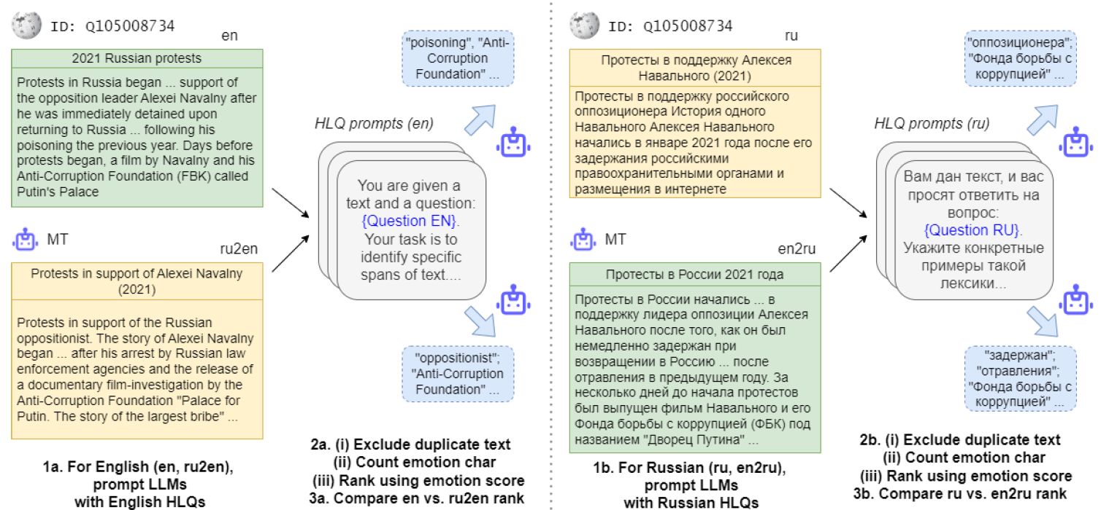
Challenge 5: Highlight areas of disagreement and agreement between RU and EN
Approved for Public Release; Distribution Unlimited: PA CLEARANCE Case Number: 2024-0352
Notes:
High-level Overview of our approach for processing four Wikipedia datasets. Left: For en and ru2en
datasets, the common language is English, and so the 12 HLQs in English are applied. For each dataset the
responses to the 12 HLQs are used to generate an emotional score. Over many articles the emotional score
can be used to get a rank. The emotional score and corresponding rank between en and ru2en dataset can be
compared. Right: For ru and en2ru datasets, the common language is Russian, and so the 12 HLQs in Russian
are applied. The other steps are the same with emotional score and corresponding rank between ru and en2ru
dataset is compared. Later in Sec 9.2 we also compare how en vs. en2ru and ru vs. ru2en ranks compare in
order to gauge how translation affects ranking.

Slide 25
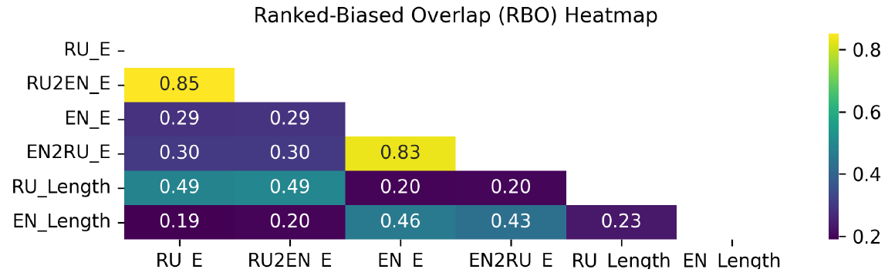
Comparing Effectiveness of Translated QA
If the translation and QA methods prove to be successful, we expect the amount of extracted text from the Russian-to-English (RU2EN) translation to be similar to that from the original Russian (RU) text.
We centered our analysis on the top 2000 (of 22,046) articles
For each dataset option we ranked using emotional score with comparison using Ranked-Biased Overlap (RBO)
Approved for Public Release; Distribution Unlimited: PA CLEARANCE Case Number: 2024-0352
Notes:
This is because the text passages with emotional content would essentially be the same in both contexts—they would merely be translations of each other. The same reasoning applies to the English-to-Russian (EN2RU) and English rankings.
However, the low RBO of 0.43-0.49, when comparing a ranking of articles based on their length vs. the
emotion score, demonstrates that the two rankings significantly differ from each other. Reinforcing the point
that it’s not feasible to replicate a ranking, similar to the one achieved via emotion scores, solely by using article
length.

Slide 26
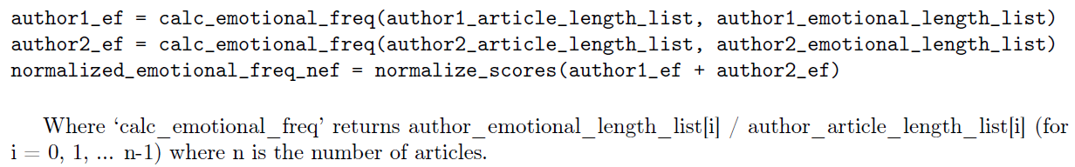
Results: by comparing amount of text extracted via questions over total text
Approved for Public Release; Distribution Unlimited: PA CLEARANCE Case Number: 2024-0352

Slide 27
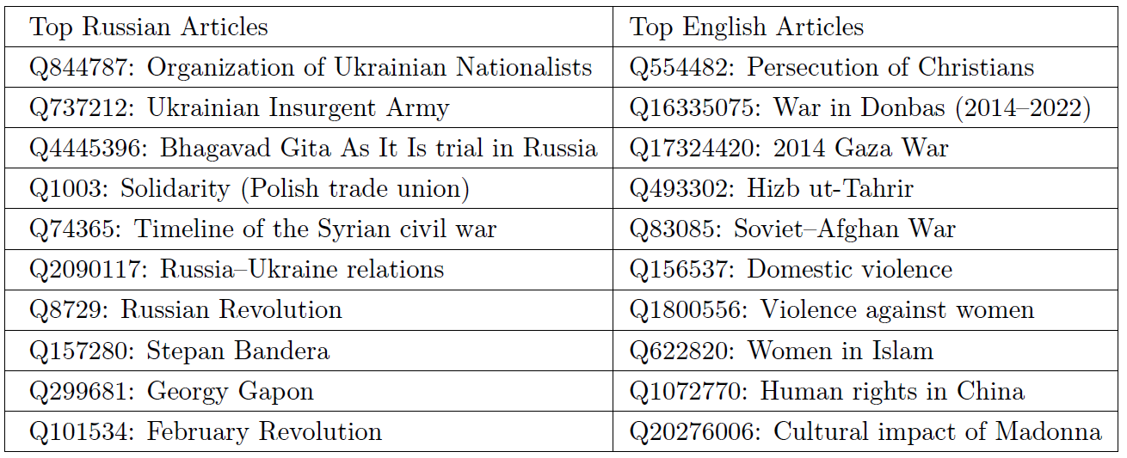
Most amount of text extracted via questions (articles):
Approved for Public Release; Distribution Unlimited: PA CLEARANCE Case Number: 2024-0352

Slide 28
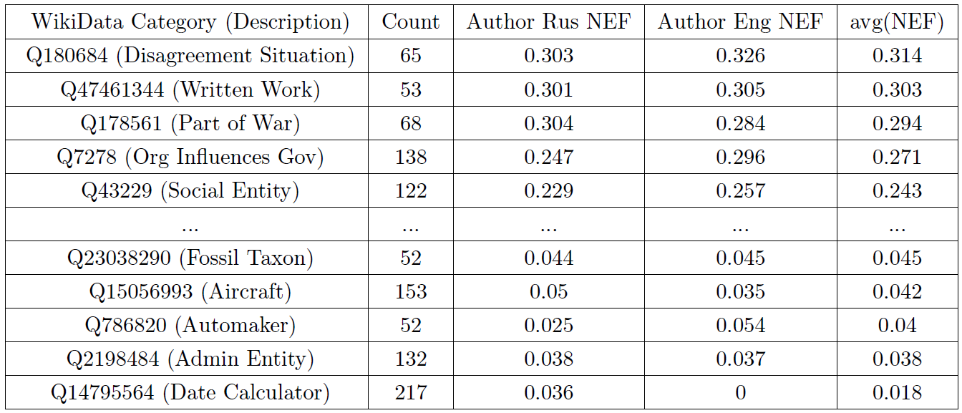
Most amount of text extracted via questions (categories):
Approved for Public Release; Distribution Unlimited: PA CLEARANCE Case Number: 2024-0352
Notes:
Top categories deal with political and societal issues like war. For
instance, written works in our dataset predominantly focused on historical atrocities, war, political repression,
and contentious analyses of societal structures. This validates our hypothesis that political-related events contain
more emotional content. As expected, more neutral categories, such as fossil taxon (Q23038290), aircraft model
groups (Q15056993), automakers (Q786820) have the least emotion.

Slide 29
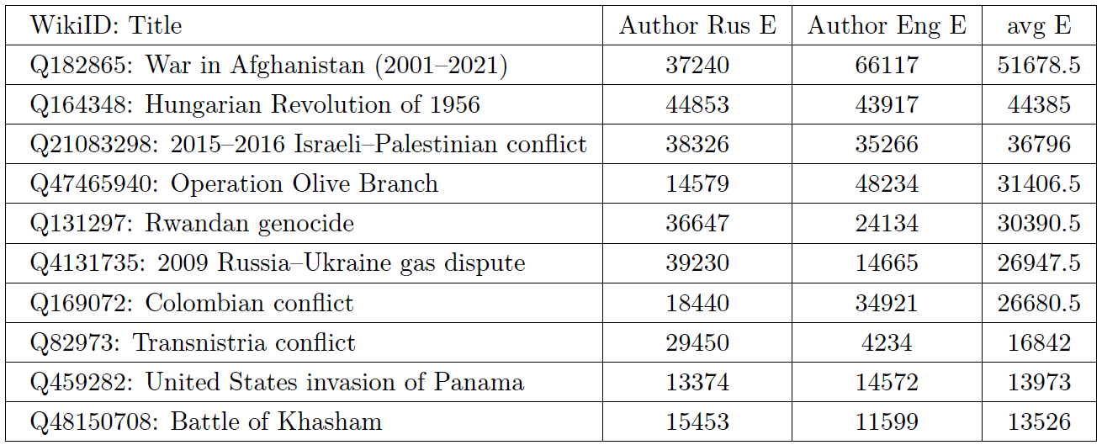
Most amount of text extracted via questions (articles in category Q180684):
Approved for Public Release; Distribution Unlimited: PA CLEARANCE Case Number: 2024-0352
Notes:
From Table, the “2009 Russia–Ukraine
gas dispute” has a lot more emotion in Russian vs. English. Conversely, the article “Operation Olive Branch"–
which deals with the Turkish Armed Forces and Syrian National Army’s conflict with the People’s Protection
Units of the Syrian Democratic Forces – displays more emotional content in English.

Slide 30
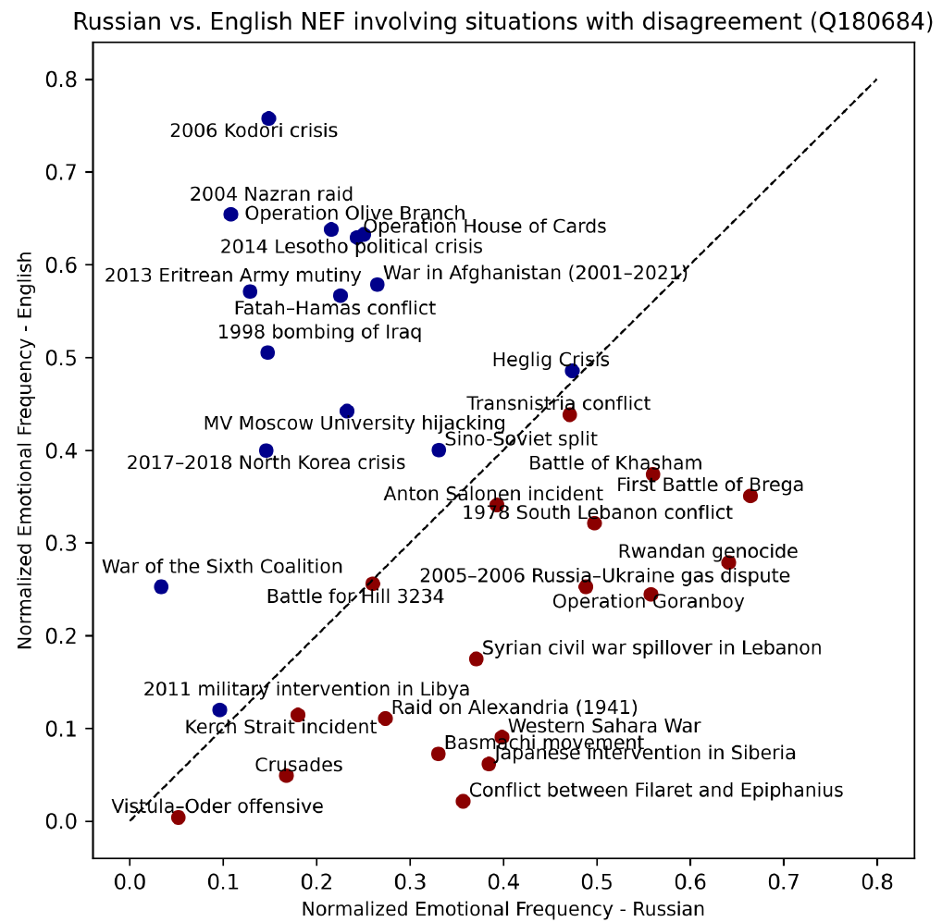
Visualize levels of text extracted via questions for each language
Approved for Public Release; Distribution Unlimited: PA CLEARANCE Case Number: 2024-0352

Slide 31
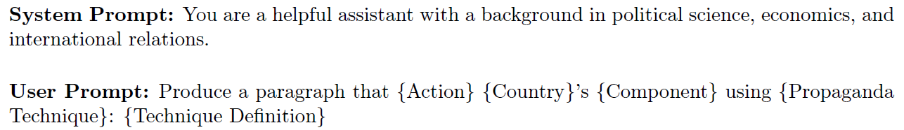
Synthetic Propaganda
The other persuasion techniques have been underrepresented, and therefore, we are motivated to release a synthetic dataset which covers all 23 SemEval techniques in a balanced way (≈10k each).
Approved for Public Release; Distribution Unlimited: PA CLEARANCE Case Number: 2024-0352

Slide 32
Using DIME like ontology for identifying components country would likely promote:
Nation state factors:
economy
military
political stability
cultural influence
technological advancements
diplomatic ties
educational excellence
infrastructure
natural resources
healthcare system
favorable trade policies
...
Russia Military
Russian Ground Forces, Russian Aerospace Forces, Russian Navy, Strategic Missile Troops, Russian Airborne Troops, Special Operations Forces, Russian Railway Troops, Russian National Guard, Military Intelligence (GRU), Russian Military Police, Federal Security Service (FSB), Nuclear Risk Reduction Centers, Russian Space Forces, Russian Electronic Warfare Troops, Russian Engineer Troops, Russian NBC Protection Troops, Russian Signal Troops, Russian Rear of the Armed Forces, Russian Logistics Support.
USA Military
United States Army, United States Navy, United States Marine Corps, United States Air Force, United States Space Force, United States Coast Guard, National Guard, Reserve components, United States Cyber Command, United States Special Operations Command, Defense Intelligence Agency, Defense Advanced Research Projects Agency, Missile Defense Agency, Defense Logistics Agency, Defense Threat Reduction Agency.
Can keep expanding ontology e.g. AFRL as subcomponent under
United States Air Force
Approved for Public Release; Distribution Unlimited: PA CLEARANCE Case Number: 2024-0352

Slide 33
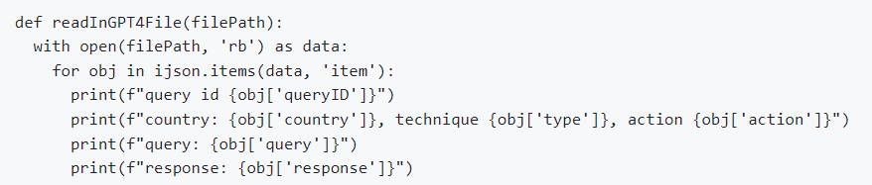
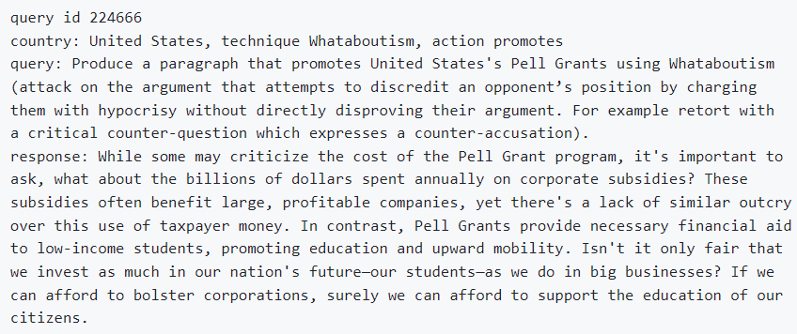
The dataset has examples for top 20 countries based on population. The dataset is a JSON file containing 225092 items.
https://github.com/apanasyu/UNCOVER_SPIE
Approved for Public Release; Distribution Unlimited: PA CLEARANCE Case Number: 2024-0352
Notes:
Some queries fail to perform specified action, i.e. can actually be promoting
vs. minimizing. GPT-4 might find some queries offensive and refuse to generate a response. Thus additional
verification is required over this dataset.

Slide 34
Conclusions
This research paper used OpenAI’s GPT-4, to analyze the emotional content communicated by Russian and English speakers. The study leveraged a dataset from Wikipedia, utilizing translation and high-level question-answering to rank articles by amount of extracted text via questions.
A key insight is the utilization of the LLM itself to create these questions, thereby showcasing the LLM’s capability to understand and apply each technique. Asking LLM to produce a confidence measure greatly improved the performance (focusing on features with confidence >= 85%)
Employing a multilingual Question-Answering (QA) approach, the questions are used to summarize emotional responses, revealing significant differences in the emotional content between languages and subjects. Neutral topics typically elicit less emotional reaction for both English and Russian. We further show that our approach works just as effectively in either language, as ranking between original and translated articles yield similar outcomes.
The paper concludes by offering a dataset of over 225,000 examples of country-level propaganda. For future research, we plan to extend our exploration of propaganda techniques. Additional propaganda annotations should facilitate more sophisticated analyses that consider not just overall emotion.
Approved for Public Release; Distribution Unlimited: PA CLEARANCE Case Number: 2024-0352

Slide 35
Questions? Contact: aleksey.panasyuk@us.af.mil

Slide 36
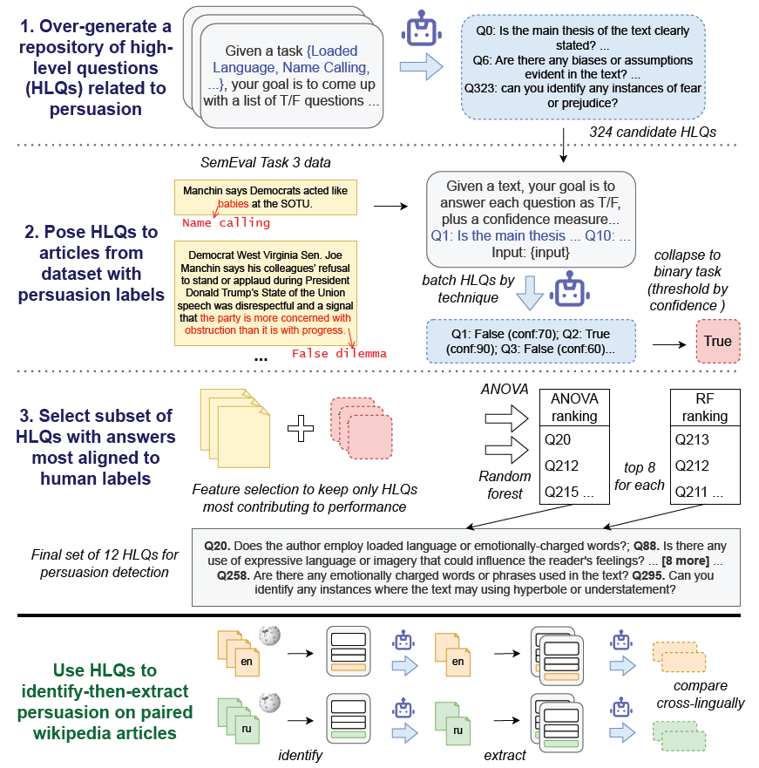
High-Level overview of Question Generation
LLM generates a large repository of high-level questions (HLQs), based on its own understanding of persuasion techniques
Perform statistical analysis to get questions which are most aligned to the SemEval data

Slide 37
Data available for the Sem-Eval 2023 Task 3
SemEval Propaganda techniques: | Train Instances | Dev Instances
Loaded_Language | 1809 | 483
Name_Calling-Labeling | 979 | 250
Repetition | 544 | 141
Doubt | 518 | 187
Exaggeration-Minimization | 466 | 115
Appeal_to_Fear-Prejudice | 310 | 137
Flag_Waving | 287 | 98
Causal_Oversimplification | 213 | 24
Appeal_to_Authority | 154 | 28
Slogans | 153 | 28
False_Dilemma-No_Choice | 122 | 63
Conversation_Killer | 91 | 25
Guilt_by_Association | 59 | 4
Red_Herring | 44 | 19
Appeal_to_Hypocrisy | 40 | 8
Obfuscation-Vagueness-Confusion | 18 | 13
Whataboutism | 16 | 2
Appeal_to_Popularity | 15 | 34
Straw_Man | 15 | 9
Appeal_to_Values | 0 | 0
Consequential_Oversimplification | 0 | 0
Appeal_to_Time | 0 | 0
Questioning_the_Reputation | 0 | 0
Approved for Public Release; Distribution Unlimited: PA CLEARANCE Case Number: 2024-0352

Slide 38
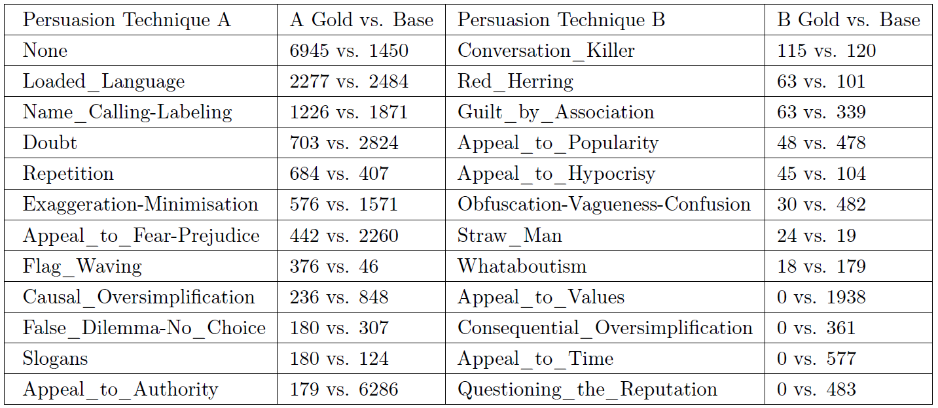
Propaganda Technique Counts in the SemEval Gold vs. GPT-4 Baseline (x > 50)
Approved for Public Release; Distribution Unlimited: PA CLEARANCE Case Number: 2024-0352
Notes:
Examples of instances where GPT-4 can be overly sensitive: ‘Email *’ (no persuasion technique in Gold)
labeled as an Obfuscation-Vagueness-Confusion technique with 75% confidence. Even though ‘Email *’ does
come across as vague, it’s not the kind of vagueness or confusion specifically designed to deflect attention away
from the main topic (593 such vagueness or confusion instances in Table 4 vs. just 30 for Gold). Similarly, merely
mentioning a news source or an individual results in GPT-4 labeling the text as containing appeal to authority
(7214 via GPT-4 vs. just 179 for Gold).

